Slide 1
CU Split Method Based on Adaptive CNN and Grandient Matrix for VVC 3D Video Depth Map
F14096148 邱柏穎

Slide 2
Abstract
Motivation
The demand for 3D videos is increasing, but the current 3D-HEVC standard is insufficient. Although VVC offers better performance than HEVC, especially for depth maps, but current research on VVC has only been limited to textur video.
Method
Proposes a fast VVC depth map coding method using texture features and deep learning.Use a gradient matrix to classify Cus and use two adaptive CNNs to do the partition.
Conclusion
Reduces coding time by 45.35% ,while BDBR only increasing by 0.23%

Slide 3
Outline
Introduction
Related Works
Proposed Algorithm
Experimental Result
Conclusion

Slide 4
Introduction 《 3D Video》
3D Videos contain more viewpoints and corresponding depth information.
Requires larger storage space and faster data transmission speed.

Slide 5
Introduction 《 Standard》
2015
2020
3D-HEVC Released
VVC Released
3D-HEVC Released
Released by the Moving Picture Experts Group and the Video Coding Expert Group
Employs some new coding tools for depth maps coding
Ex : Depth modeling mode (DMM), segment-wise DC coding (SDC), depth intra skip (DIS), and view synthesis optimization (VSO)

Slide 6
Introduction 《 Standard》
2015
2020
3D-HEVC Released
VVC Released
VVC Released
Released by Joint Video Experts Team (JVET)
4K videos and 360-degree video
Defines 65 different basic intra prediction directions for brightness prediction blocks.
Adopts a new and more flexible partitioning structures, namely QTMT.

Slide 7
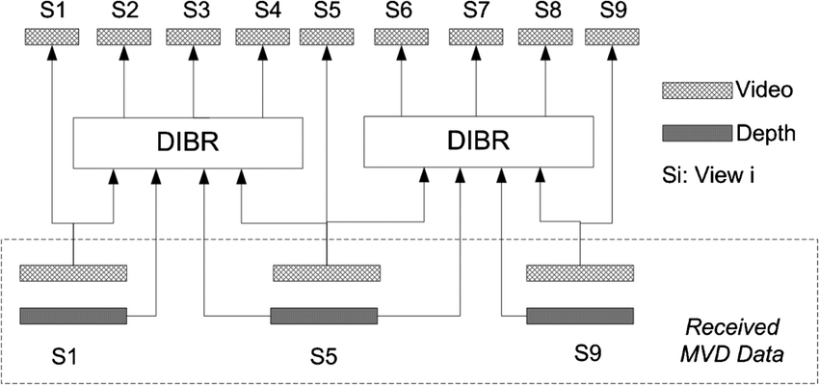
Introduction 《 3D Video》
MVD format : requires encoding and transmitting texture and depth maps from three different viewpoints.
Huge amount of data !!

Slide 8
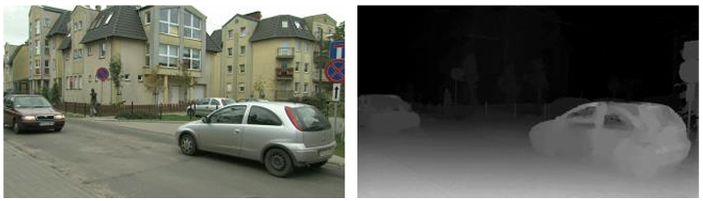
Introduction 《 Depth maps & Texture map》
Depth maps
1. Grayscale images, where the grayscale values represent the distance between the camera and the object.
2. Has less edge information than texture maps
3. The segmentation depth in the flat area is often lower, while in the sharp edge area, the encoder tends to choose small size blocks for encoding.
→Traditional CU partitioning method for texture maps is not suitable for depth maps.
Texture maps
1. Contains a lot of texture information.

Slide 9
Introduction 《 Proposed algorithm》
Classify CUs
Use Gradient matrix to divide CU into three types.
1. Simple CU → terminate its partitioning process.
2. Fuzzy CU → Uses original encoder algorithm.
3. Complex CU → Uses two adaptive CNNs to accelerate its partition process.
Adaptive CNNs
1.First CNN → Determine quadtree partitioning or multi type tree partitioning on square CUs
2.Second CNN → Determine horizontal or vertical tree partitioning for CUs

Slide 10
Related Works 《 Approaches for 3D-HEVC》
Unsupervised learning method
Determine different size of CU
Deep learning method
Sum of gradient to calculate the flatness
Treats residual signals as features

Slide 11
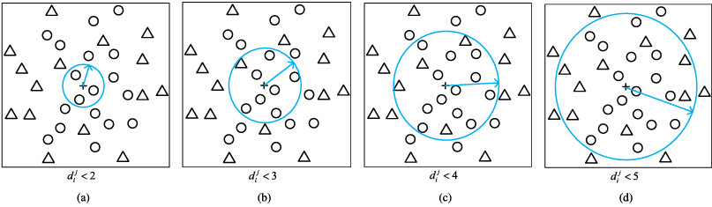
Related Works 《 Approaches for 3D-HEVC》
<Tunable early CU size decision for depth map intra coding in 3D-HEVC using unsupervised learning>
Used an unsupervised learning method to accelerate the CU partitioning process of depth maps
Three K-means clustering methods to determine 64x64, 32x32, 16x16 size CU
<A computation complexity reduction of the size decision algorithm in 3d-HEVC depth map intracoding>
Calculate the sample of simplified mass center (ASMCV) and the variance, and compare them with four thresholds to construct CU size decision model

Slide 12
Related Works 《 Approaches for 3D-HEVC》
<Fast partition algorithm in depth map intra coding unit based on multi-deep convolution neural network>
Use deeplearning methods to make decision of 3D-HEVC depth map CU quadtree partitioning
Create Multi Deep Convolutional Neural Network (MD-CNN)
Can directly predict the partitioning mode
<Self-learning residual model for fast intra CU size decision in 3D-HEVC>
Disguise the self-learning residual model as a binary classifier
Treats residual signals as features of each CUs
<Sum-of-gradient based fast intra coding in 3D HEVC for depth map sequence (SOG-FDIC)>
The division depth of coding units in flat regions in depth maps is not very deep
Use sum of gradient to calculate the flatness of CUs

Slide 13
Related Works 《 Approaches for VVC 2D Video》
<Accelerating QTMT-based CU partition and intra mode decision for versatile video coding>
Select three important features and trains five SVM models for Cus of sizes from 8x16 to 32x32
Use Laplace operator to determine the general direction
<A Fast Algorithm for Intra-Frame Versatile Vid eo Coding Based on Edge Features>
Divided CU in to two types
Complex region → Calculated edge feature value and compared with two thresholds
Simple region → Use the difference between division depth and division depth of adjacent CUs to determine the end of process
<Fast CU Partition Method Based on Extra Trees for VVC Intra Coding>
Constructed two extra tree models to determine current direction of partition and partition into binary tree or ternary tree

Slide 14
Related Works 《 Approaches for VVC 2D Video》
<Unified Fast Partitioning Algorithm for Intra and Inter Predictions in Versatile Video Coding>
Diminish the complexity of intra and inter frame prediction coding
<Fast multi type tree partitioning for versatile video coding using machine learning>
Swift CU size decision strategy
Construct a lightweight neural network (LNN) model to determine whether the current CU needs ternary partition or bunary tree partition
Threr are few papers on VVC 3D video in the field of scientific researt !

Slide 15
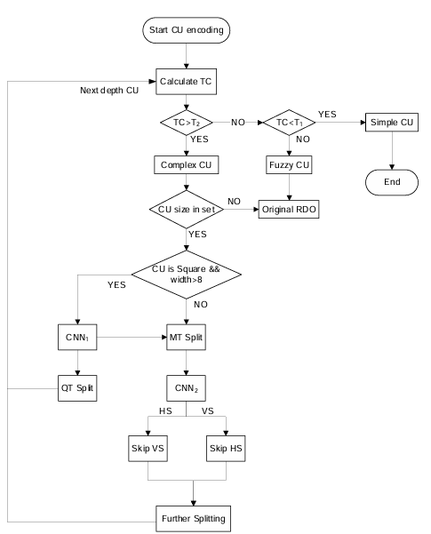
Proposed Algorithm
Classification:
Use gradient matrix and threshold to classify CU into three types, namely simple,fuzzy,complex.
Simple CUs :
terminated the process
Fuzzy CUs :
Perform RDO calculation, which is the origin process.
Complex CUs :
Fed the Cus into subsequent CNN models.

Slide 16
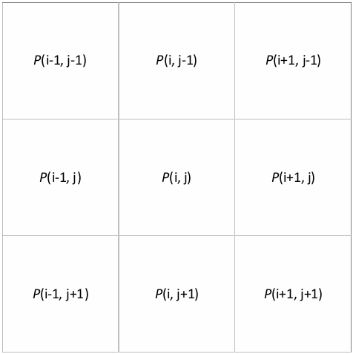
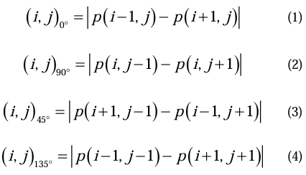
Proposed Algorithm 《 CU classification Model Based on Gradient Matrix》
Gradient Matrix:
For every (H-2)x(W-2) non edge gray value in depth map, form a matrix of 3x3 size with surrounding grayscale values.Each element in gradient matrix represents the texture complexity of the local area.

Slide 17
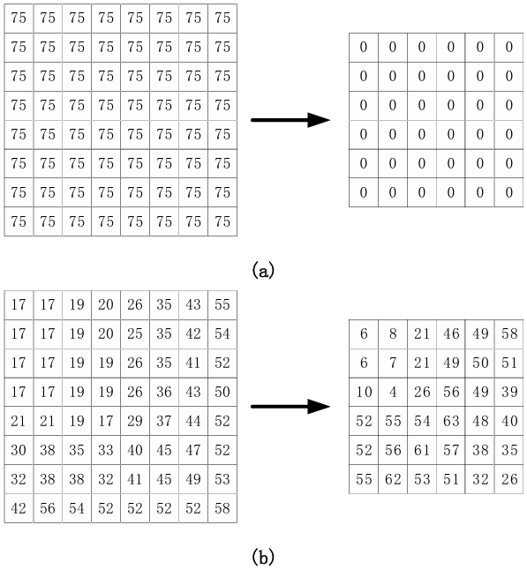
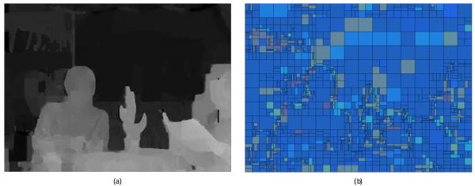
Proposed Algorithm 《 CU classification Model Based on Gradient Matrix》
Result: Flat area → Most of the elements almost zero.
Sharp area → Larger element value.

Slide 18
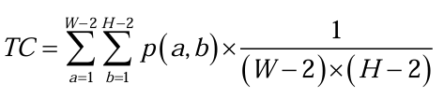
Proposed Algorithm 《 CU classification Model Based on Gradient Matrix》
Texture Complexity (TC): Calculate the TC and comparing with the preset threshold, divide the CU into simple CU,fuzzy CU and complex CU.

Slide 19
Proposed Algorithm 《 CU classification Model Based on Gradient Matrix》
Threshold Setting:
Use the method of training frames to dynamically adjust the threshold.
Define the first frame as the training frame.
Obtain two ideal threshold T1 and T2 and updated every 30 frames.

Slide 20
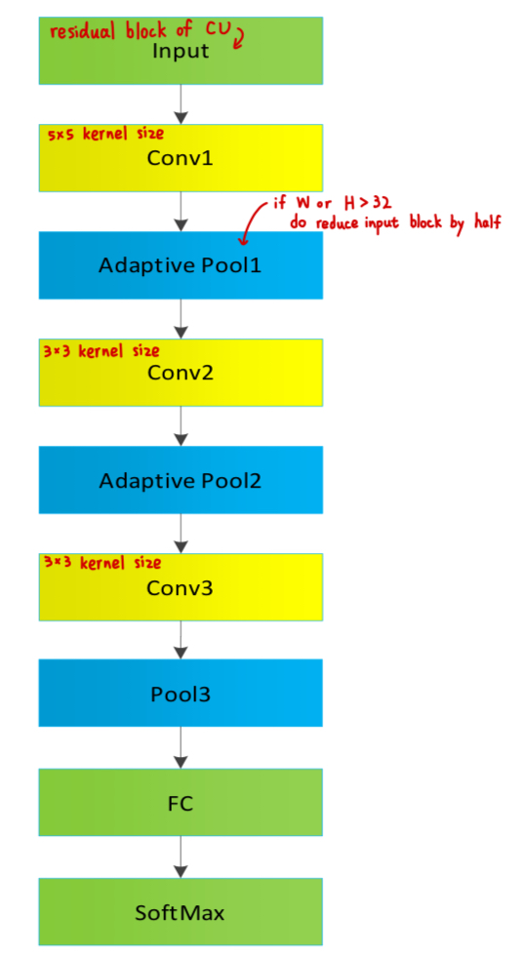
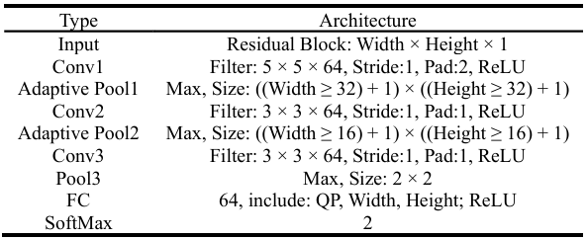
Proposed Algorithm 《 Adaptive CNN Structure》
Present a CNN network model with bariable pooling layer size to ensure that the final output feature map size is consistent.

Slide 21
Proposed Algorithm 《 CNNs Training》
In order to make two CNNs complement to each other.
If the current CU is square
→ input into the first CNN model first
If the prediction result is MT partition
→ input the residual block of the CU into the second CNN model
Square CUs must be filtered by the first CNN model before second CNN model.

Slide 22

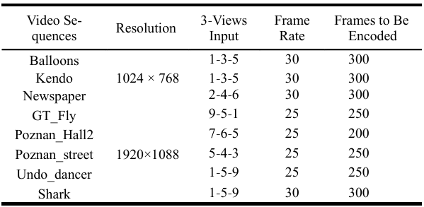
Proposed Algorithm 《 CNNs Training》
Optimization algorithm
Stochastic Gradient Descent(SDG) algorithm
Loss function
Training Data

Slide 23
Experimental Results 《 Environment Setting》
CPU
Intel (R) Core (TM) i7-10700 K , RAM 32 GB
GPU
RTX 3070
Original Encoder
VTM 10.0
Encoding configuration
All intra and QP (depth) set to 34, 39, 42, and 45

Slide 24

Experimental Results 《 Performance metircs》
Bjøntegaard delta bit rate (BDBR)
Represent the rate savings under a certain objective encoding quality
Negative value → Improvement in encoding performance
Positive value → A loss in encoding quality
Time Reduction (TR)

Slide 25
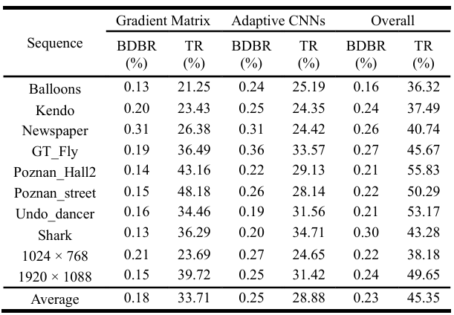
Experimental Results 《 Algorithm performance analysis》
Exam their performance when acting alone
Both of the proposed sub algorithm can diminish the complicacy of depth map encoding and maintain almost no loss of encoding quality
The video sequence of Poznan_street has a large flat area
→Best performance in first sub algorithm

Slide 26
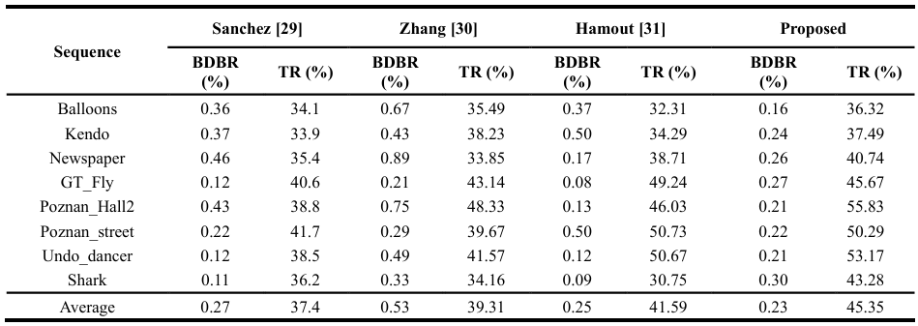
Experimental Results 《 Performance Comparison》
Diminish coding time by 7.95% on average

Slide 27
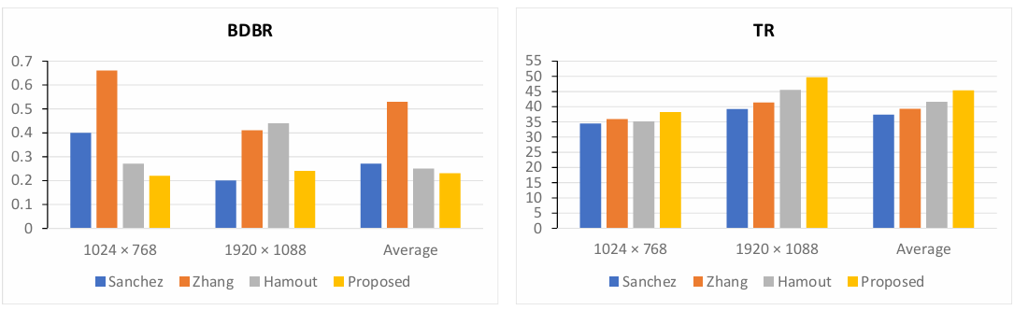
Experimental Results 《 Performance Comparison》

Slide 28
Conclusion
Provide a method to reduce the complexity of intra frame coding unit partitioning in VVC 3D
Result indicate that the proposed solution can diminish encoding time by 45.35%, while BDBR only increases by 0.23 %
Contributed to 3D video encoding and accelerated its application speed in real life

Slide 29
Thank you

